Slide 1

Orange Labs Egypt QClub Our Profile ☺
19 October 2016

Slide 2

Agenda
What we do
Our Tools
Our Software Development Process
Our Activities
What we need to do
Our Success Stories ☺
Appium –Mobile Testing-Workshop
Jmeter Performance Testing-Workshop
Robot Framework-Workshop

Slide 3

What we do

Slide 4
Testing Types
Functional Testing
Non-Functional Test
Performance Testing
Acceptance Testing
Change Based
Usability Testing
Re-Testing
Regression
UI Testing
Localization
Interoperability
Backend&API Testing
Security Testing
Notes:
What is Interoperability Testing
Interoperability testing is nothing but to check whether software can inter-operate with other software component, software's or systems.
For example, interoperability testing is done between smartphone and tablet to check data transfer via Bluetooth.
Risk associated with Interoperability Testing
The risk associated due to lack of Interoperability Testing are
Loss of data
Unreliable performance
Unreliable operation
Incorrect operation
Low maintainability

Slide 5










Our Tools

Slide 6


Performance Testing | Security Testing
YSlow PgaeSpeed Insights Blazemeter Jmeter Bug Tracking | OWASP Zed Attack Acunetix Web Vulnerability Scanner Advanced Cooki Manager SQL InjectMe Source Control
Jira (Bug Tracking tool, Project Management) ALM Orange Forge Trello | SVN Git
Notes:
http://yslow.org/
Minimize HTTP Requests
Use a Content Delivery Network
Avoid empty src or href
Add an Expires or a Cache-Control Header
Gzip Components
Put StyleSheets at the Top
Put Scripts at the Bottom
Avoid CSS Expressions
Make JavaScript and CSS External
Reduce DNS Lookups
Minify JavaScript and CSS
Avoid Redirects
Remove Duplicate Scripts
Configure ETags
Make AJAX Cacheable
Use GET for AJAX Requests
Reduce the Number of DOM Elements
No 404s
Reduce Cookie Size
Use Cookie-Free Domains for Components
Avoid Filters
Do Not Scale Images in HTML
Make favicon.ico Small and Cacheable

Slide 7

Test Automation Selenium Webdriver Robot Framework Appium Protractor Jasmine Framework DB Tools/Engines Heidi PHP My Admin Oracle Toad My SQL SQL Developer Mongo DB | API Testing SoapUI Jmeter Rest Client Post Man Advanced Rest Client Fiddler Charles Custom Tools (Java,Python)

Slide 8
Scripting Language Java Python C# Java Script Shell IDEs Eclipse Intellij NetBeans Ride PyCharm | Testing Methodologies Agile Scrum Kanban CI Tools Jenkins Custom (Maven,Ant)

Slide 9

Our Software Development Process

Slide 10
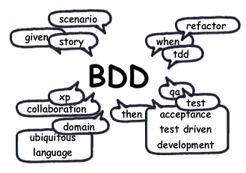
Behavior-Driven Development
Brings these people together
Product Owner
Quality Engineer, Software Engineer
Customer (if possible)
Human readable test cases
Written by Quality Engineers
Automated by developer
BDD ensures all development projects remain focused on delivering what the business actually needs while meeting all requirements of the user.

Slide 11

Our Activities

Slide 12
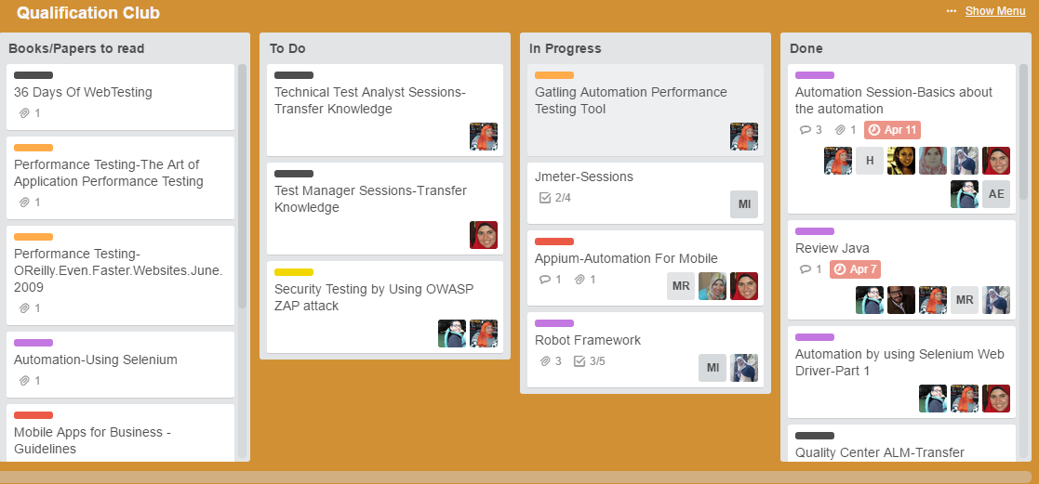

Slide 13

What we need to do
“Quality means doing it right when no one is looking.” (Henry Ford)

Slide 14

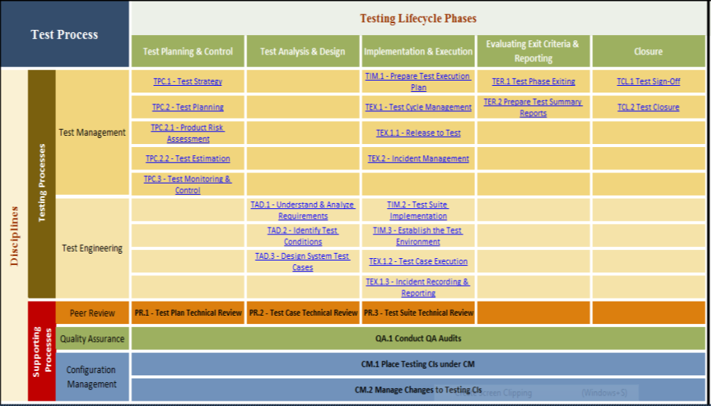
Quality Process (TPIG)

Slide 15
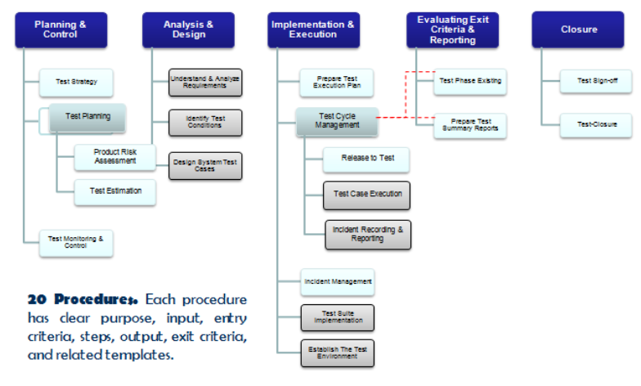
TPIG Procedural Structure

Slide 16
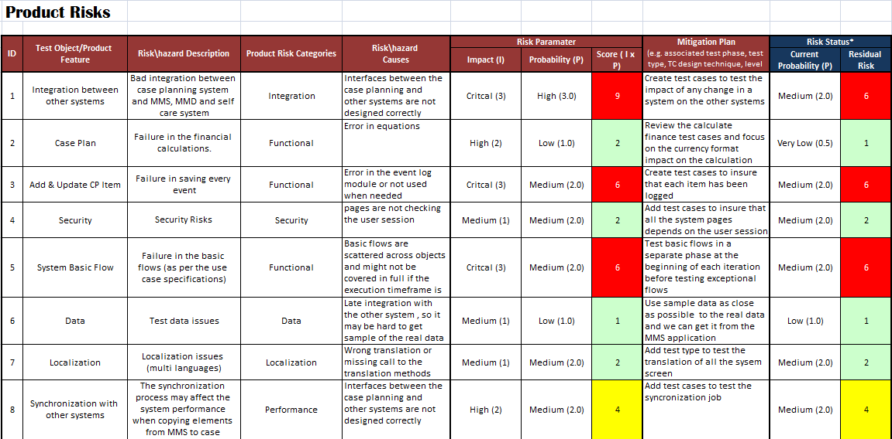
TPIG Methods & Techniques
Generic Risk Assessment

Slide 17
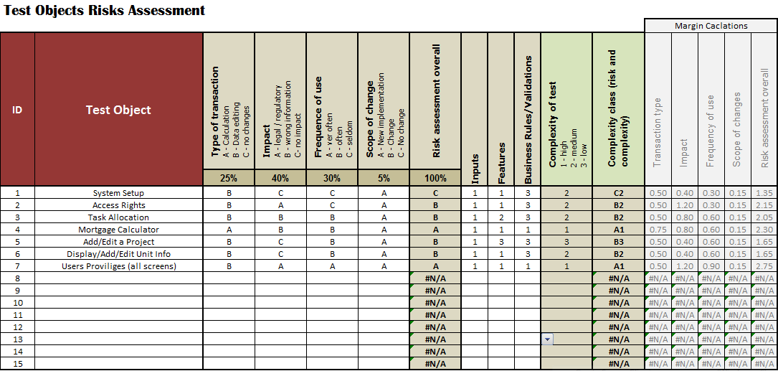
2. Detailed Risk Assessment

Slide 18
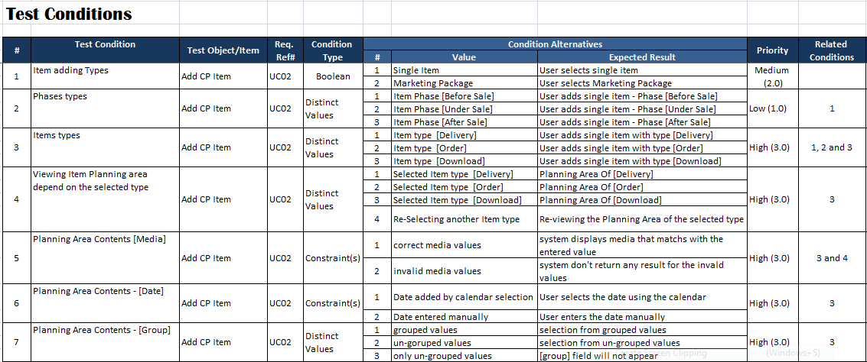
3. Test Analysis & Design

Slide 19
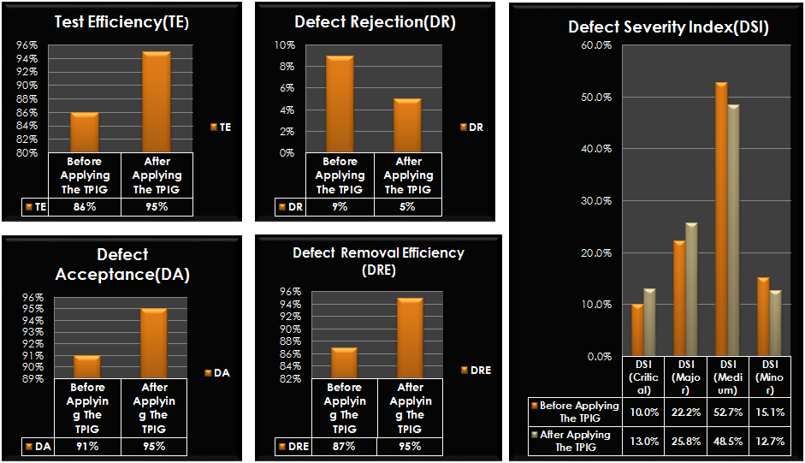
The Result Of Applying The TPIG

Slide 20
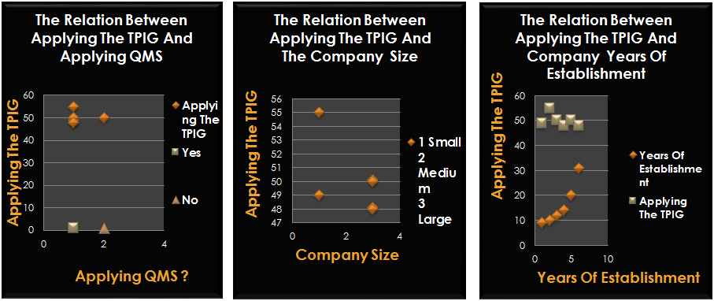
The Result Of Applying the TPIG (Cont’)

Slide 21

Our Success Stories ☺

Slide 22
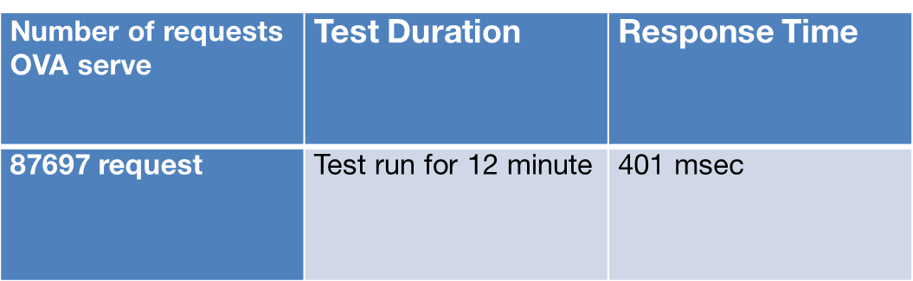
OVA JMeter Results
problems JMeter detected:
Log Files Saturation
Unclosed Session For follow-ups
Results for simple question:

Slide 23
OVA Results cont.
Results On Follow Up Question:
Number of requests OVA serve | Test Duration | Response Time
62786 request | Test run for 16 minute | 806 msec
109925 request | Test run for 30 minute | 815 msec
121425 request | Test run for 45 minute | 850 msec
127697 request | Test run for 1 hour | 870 msec

Slide 24

Air Box Test Automation

Slide 25
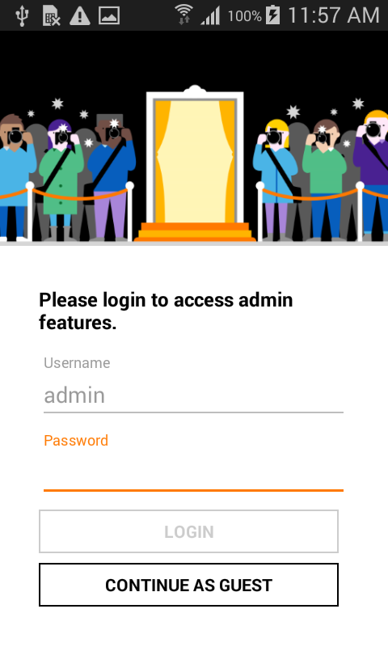
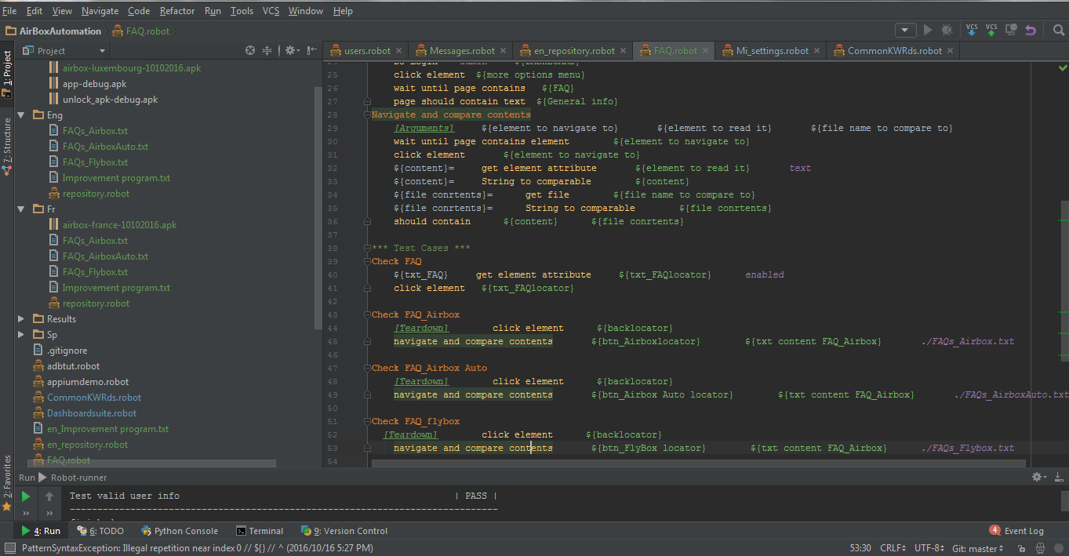
Air Box Test Automation Project

Slide 26
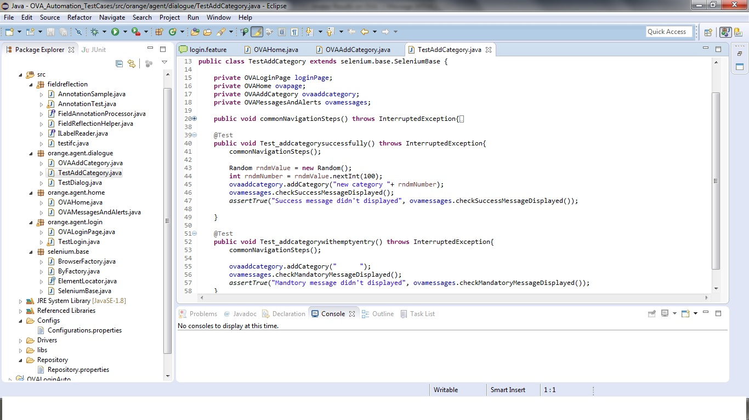
OVA Automation Using Selenium

Slide 27
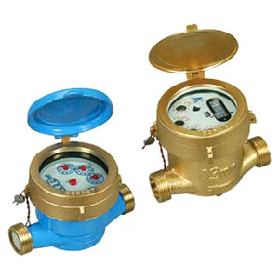
SM Functional Testing

Slide 28
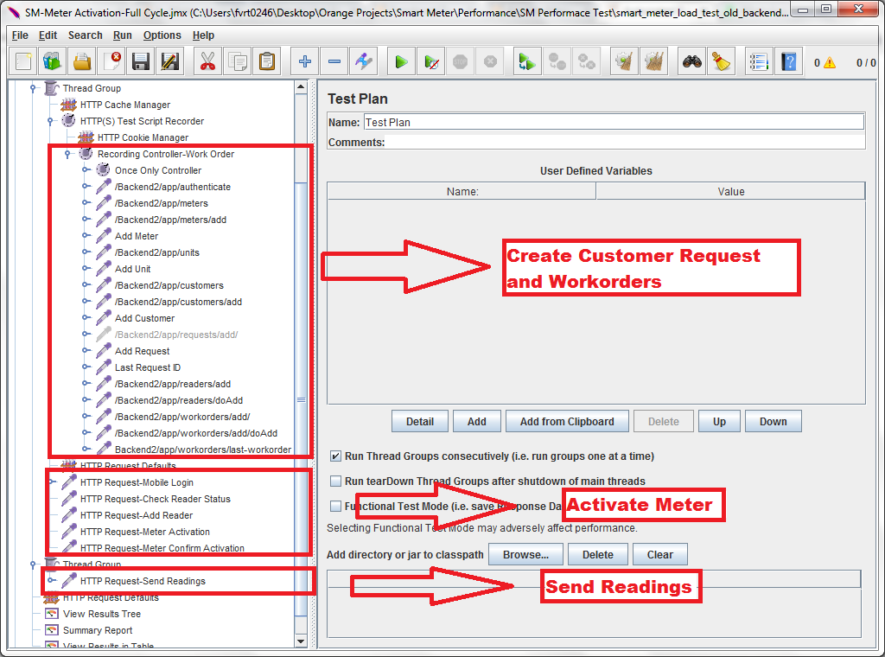
Automate Activation Meter Cycle
1
2
3

Slide 29
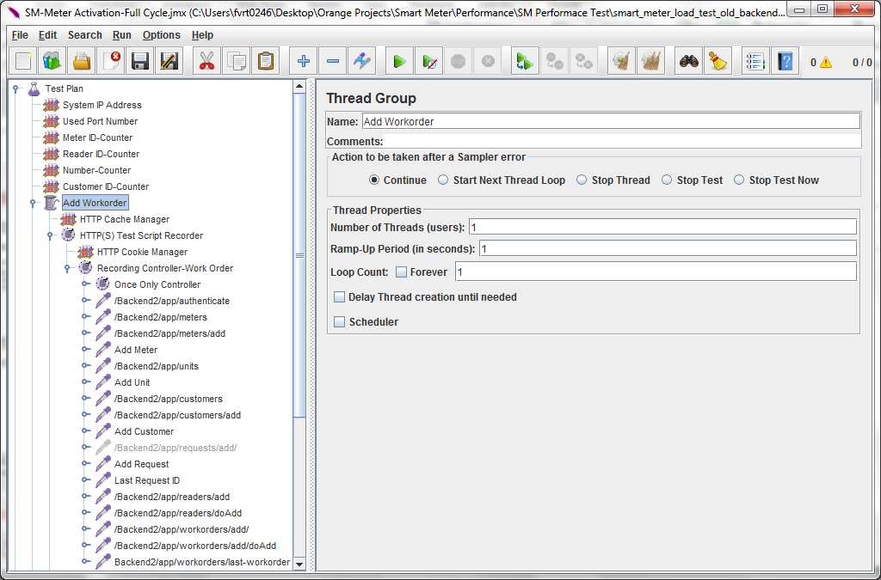
Add Work-order
Scenarios for adding a work-order
User Authentication
Add Meter
Add Units
Add Customer
Add Request
Add Reader
Add Work-Order

Slide 30
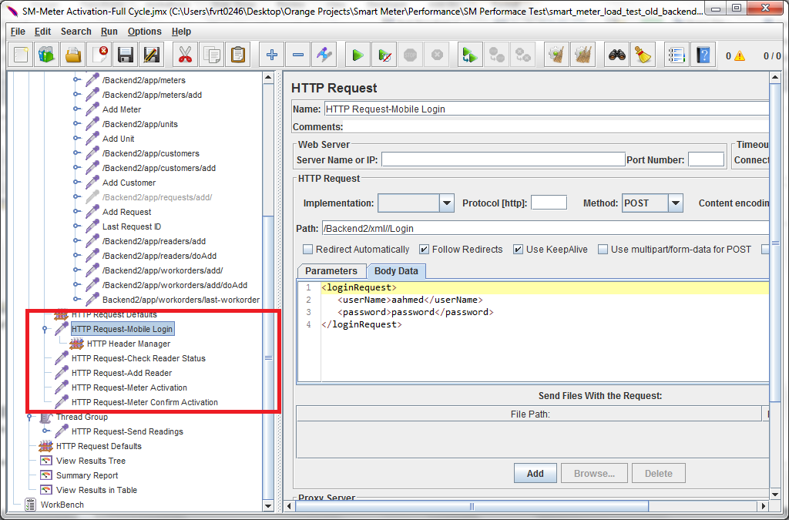
Activate Meter-Mobile App
Scenarios for activating Meter-Mobile App
Mobile application authentication
Check reader status
Meter Activation
Meter Confirm Activation

Slide 31
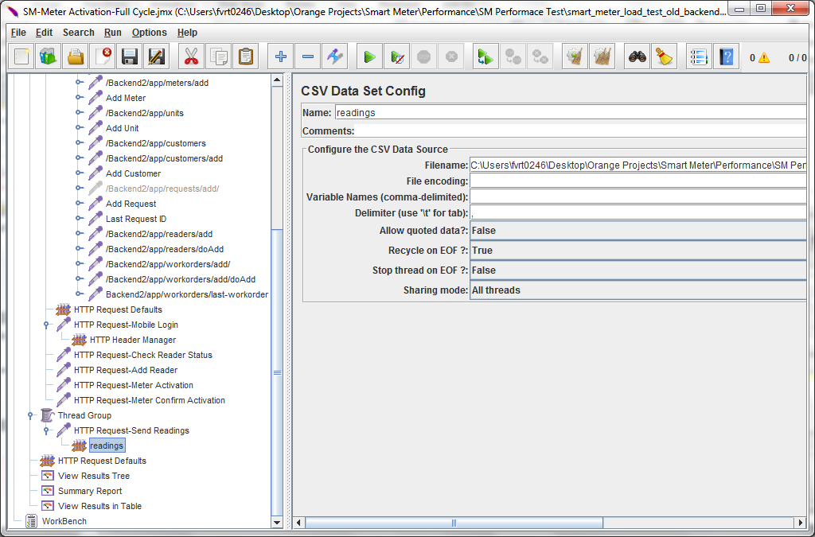
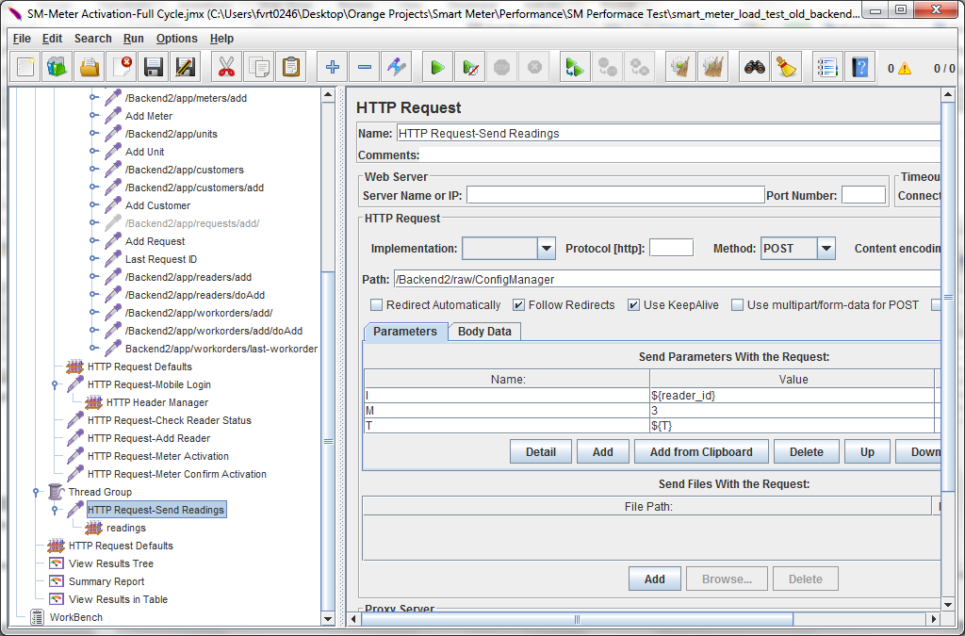
Send Readings

Slide 32
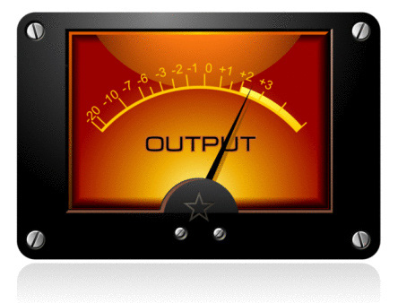
SM Performance Testing

Slide 33
The Average Response Time For Sending 1000 Readings in 1000 ms

Slide 34
The Average Response Time For Sending 2000 Readings in 2000 ms

Slide 35
The Average Response Time For Sending 3000 Readings in 3000 ms

Slide 36
The Average Response Time For Sending 4000 Readings in 4000 ms

Slide 37
SM Security Testing

Slide 38

Security Testing Tools
OWASP ZAP
Acunetix Web Vulnerability Scanner

Slide 39
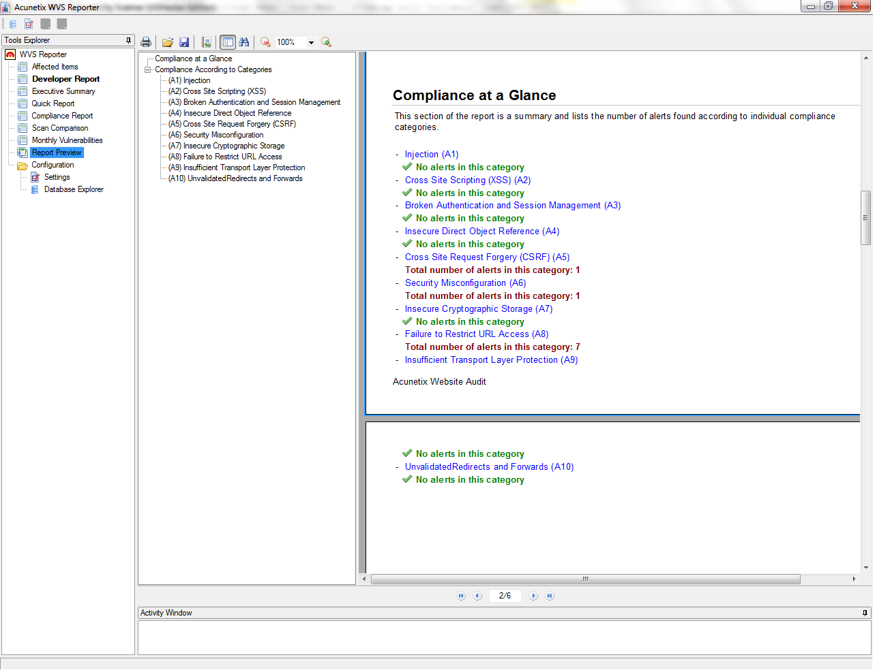
SM Security Testing-Vulnerability Issues

Slide 40
That’s it! ☺

Slide 41
Thank you ☺
12 March 2015

